Slide 1
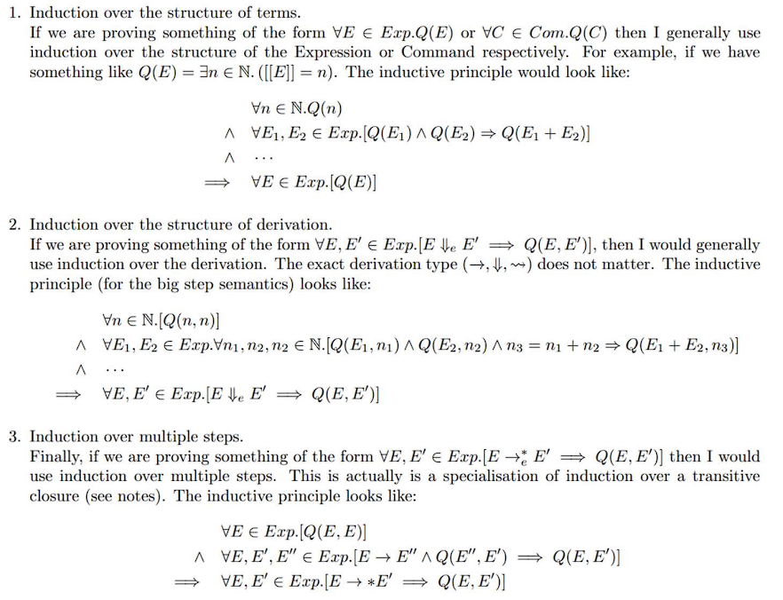
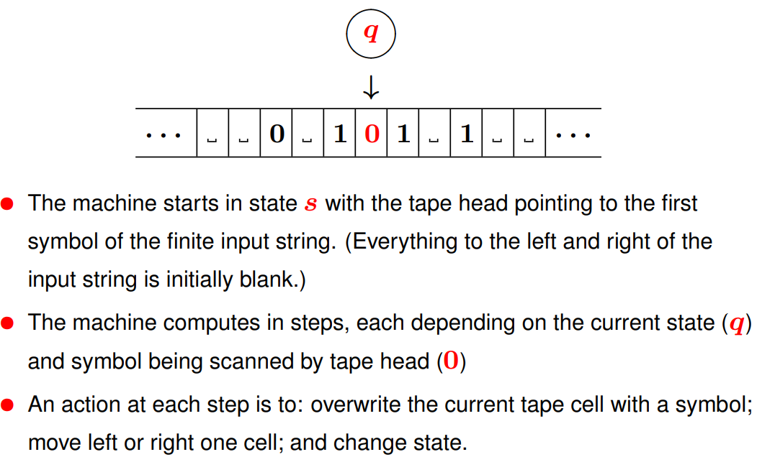
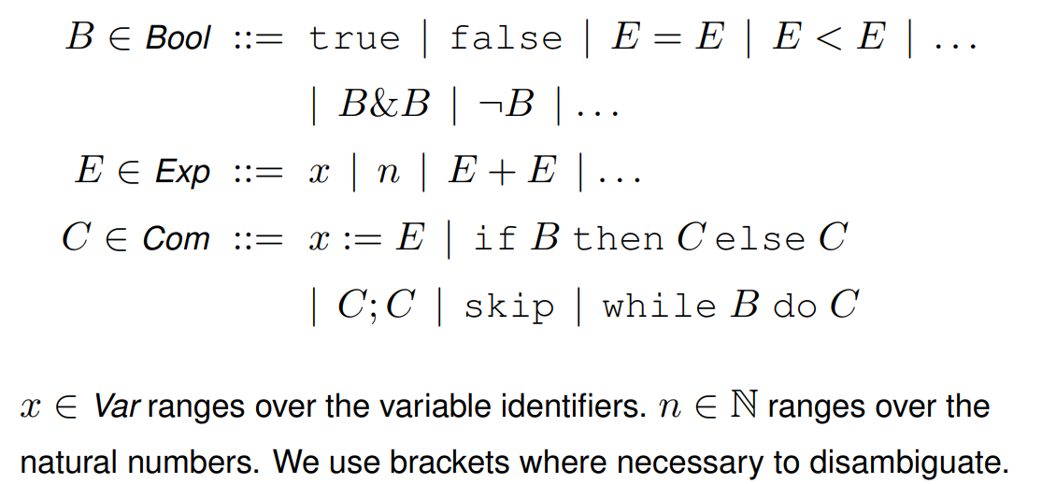
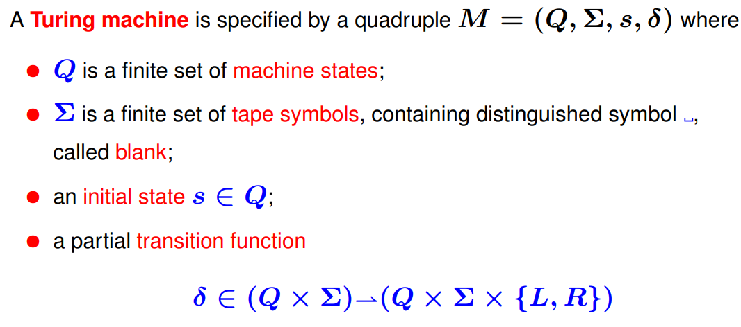
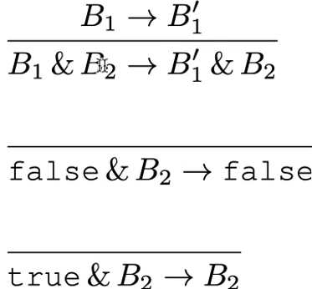
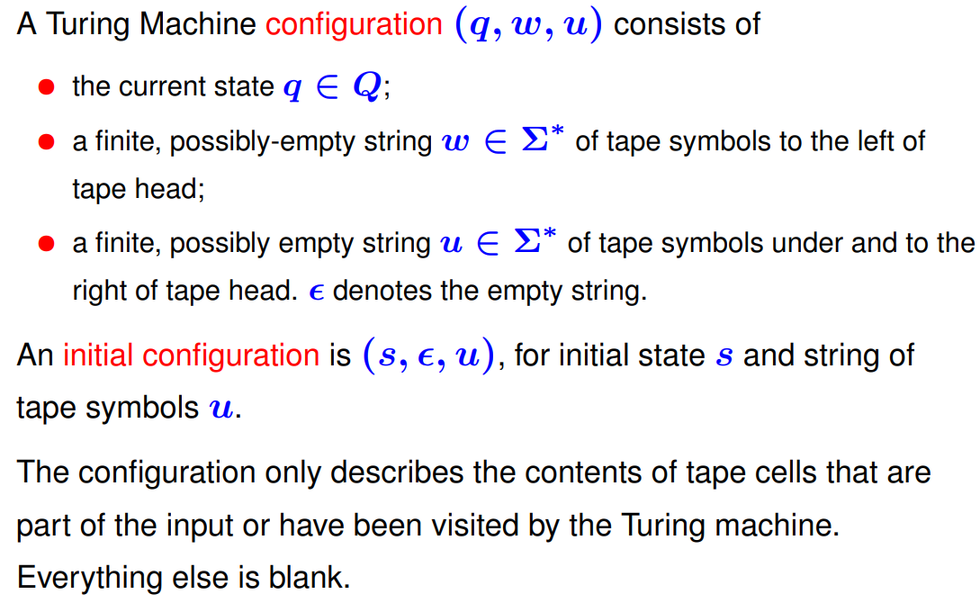
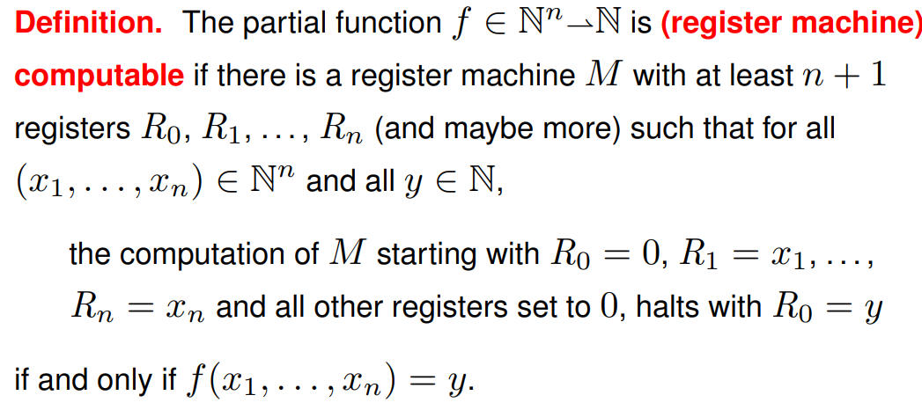
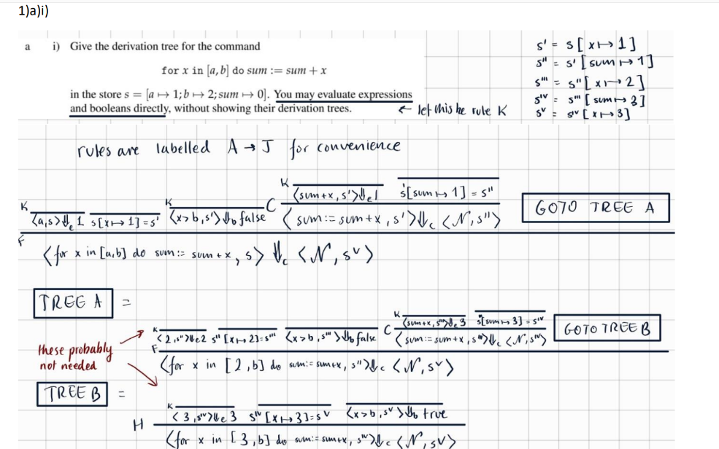
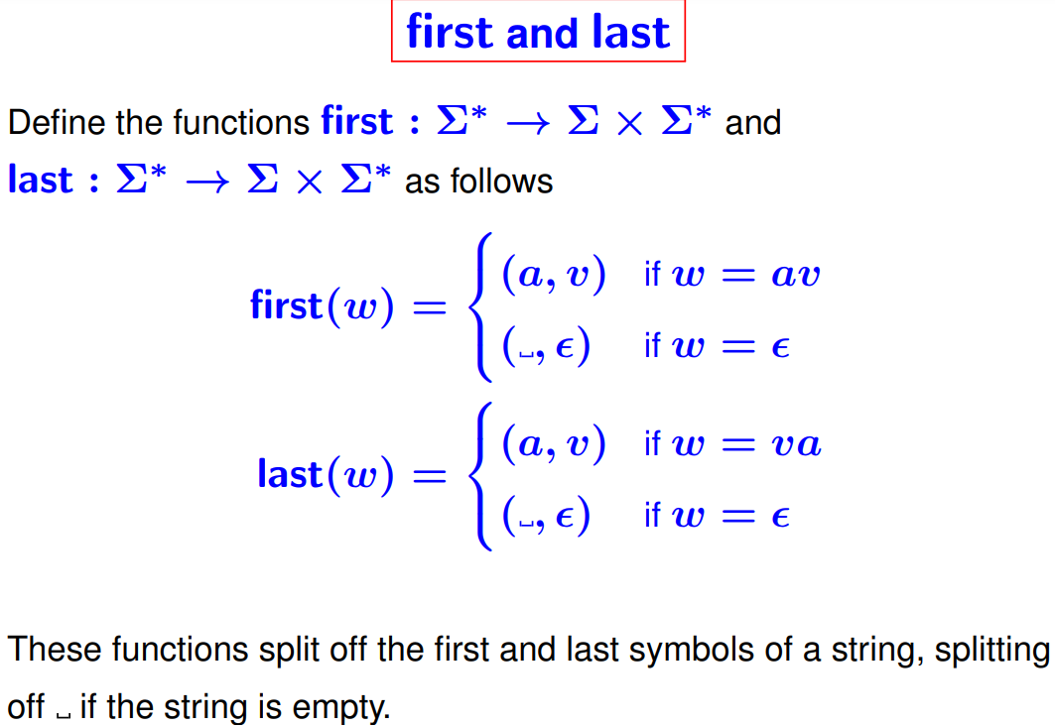
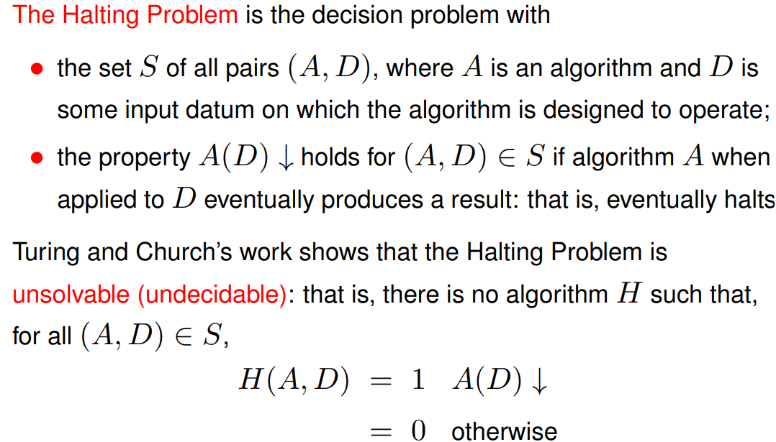
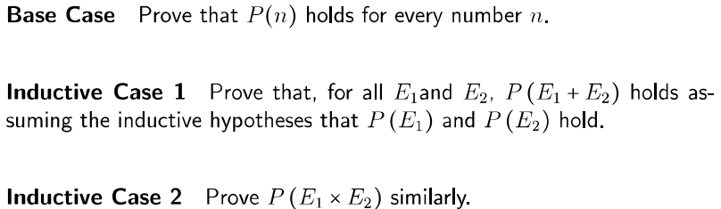
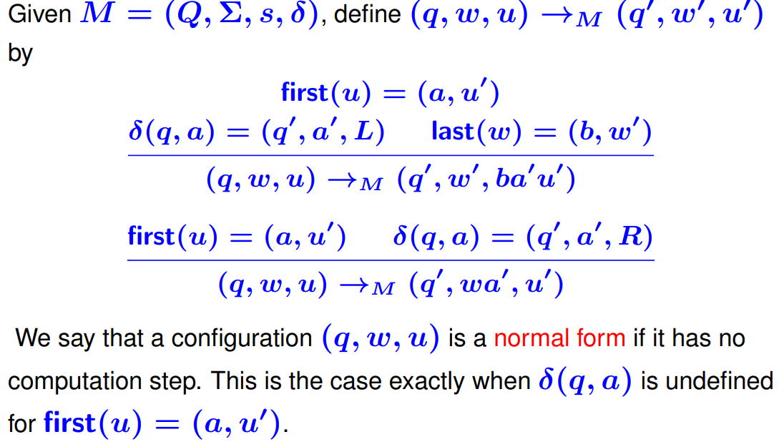
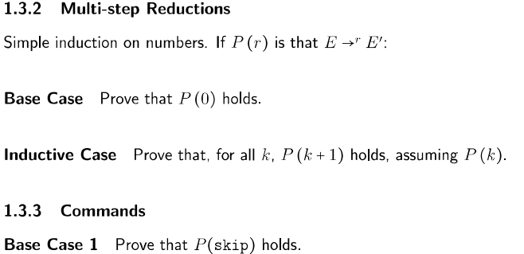
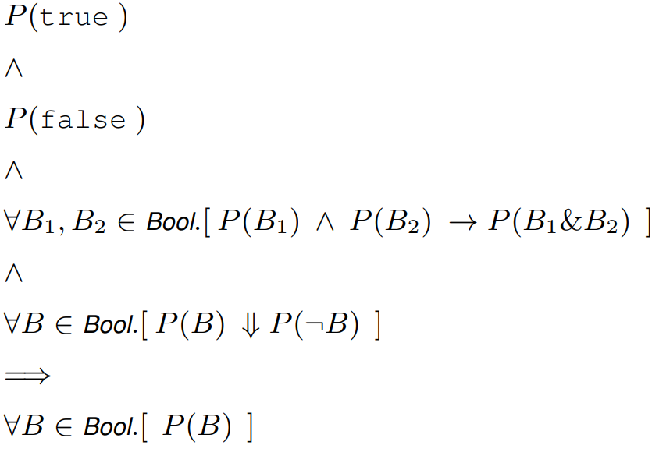
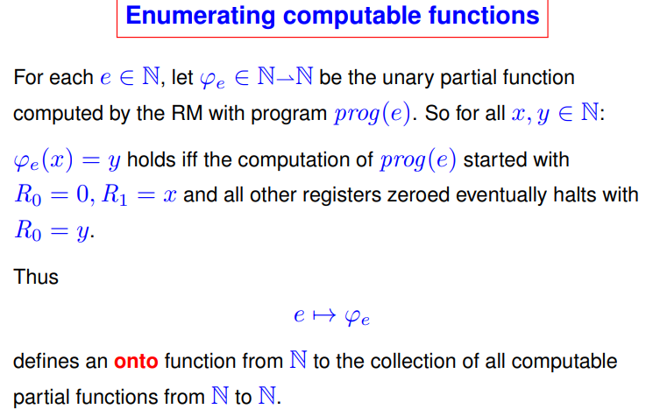
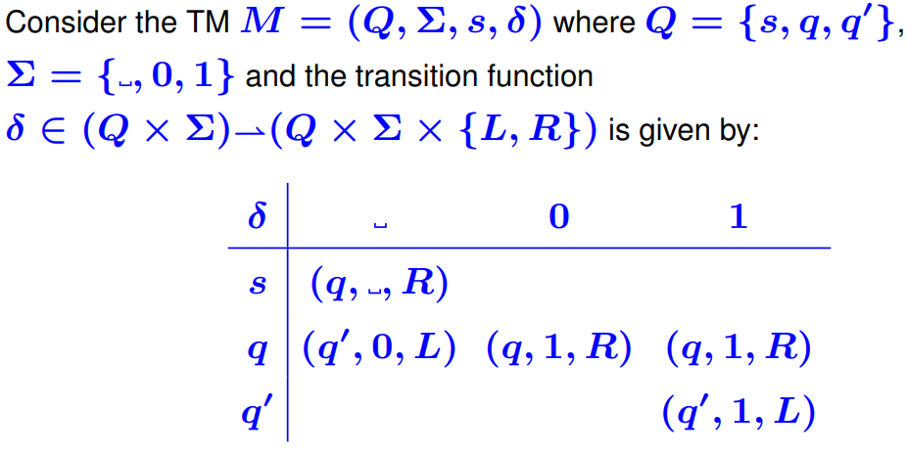
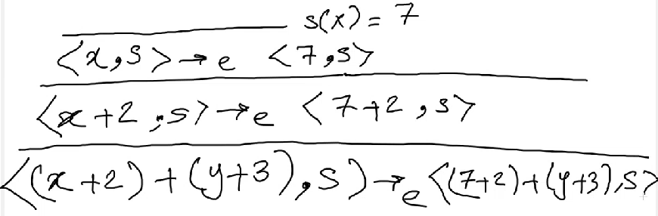
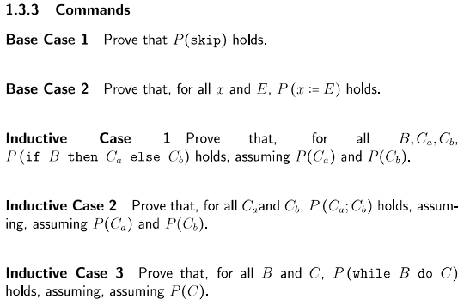
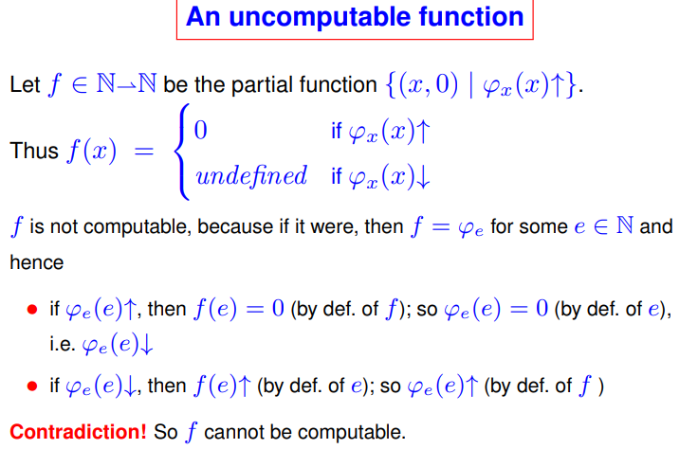
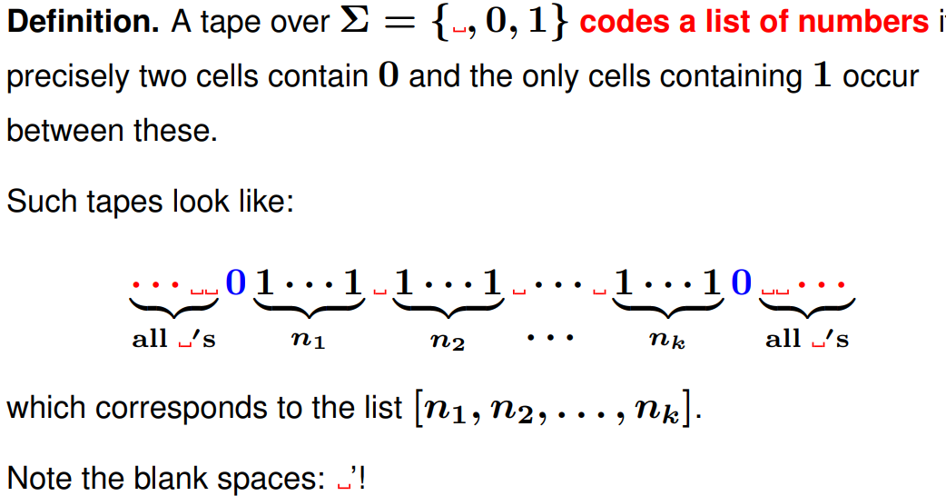
Models of Computation
WHILE Language. x∈Var ranges over variable identifiers, n∈N ranges over nat nums.
1.1) Evaluation Properties
1) Determinacy: We always evaluate to the same result – e.g: if E⇓n₁ and E⇓n₂, n₁=n₂
2) Totality: We always get a result in normal form: e.g: for all E, there is n such that E⇓n
3) Reflexive Transitive Closure: →* means 0 or more iterations of →, and n is the final result we get to if E →* n
4) Normal Form: An Expression E is in normal form (and said to be irreducible), if there is no E’ such that E -> E’.
5) Confluence: For all E, E₁,E₂, if E→*E₁ and E→*E₂ then there exists E’ such that E₁ →*E’ and E₂ → *E₁ (AKA there might be several evaluation paths but they all get to the same result).
Determinance → Confluence
6) Strong Normalisation: There are no infinite sequences of expressions E₁ → E₂ → E₃, such that for all i, E_{i} → E_{i+1}. That is, we always reach a normal form.
1.2) Simple Expressions
E ∈ SimpleExp ::= n | E + E | E x E …
Normal Form of Expressions: All expressions have a normal form, which are the Natural numbers.
Big Step Semantics: Our rules make us “Leap to the final result”. Properties: Determinacy, Totality.
Small Step Semantics: “Show the evaluation of each step according to the rules”. Properties: (that we must ensure our definitions of small step semantics have): Determinacy, Confluence, (Strong) Normalisation.
Link between Big and Small step semantics:
For all E and n, E⇓n if and only if E→*n
1.3) State
We consider state – s = (x → 2, y → 200). It’s a variable store. We define our configurations with the form <E, s> <B, s> and <C, s> (a Expr, Boolean or Command and the state).
M1) Derivation Trees
We obtain derivation trees by working from the bottom upwards. We start with the step we want to work out, then find which rule pattern matches it and put it above. We continue until we have a definite final step.
All the other rules are standard, note W-WHILE: Which doesn’t actually do any execution, it just unrolls the loop
We have Determinacy and Confluence for the evaluation of Booleans and Expressions and Commands (→_{b}, →_{e},→_{c}).
Additionally, →_{b}, →_{e} are normalising, but →_{c} thanks to the presence of (potentially infinite) while loops.
1.4) The Answer Configuration (ACs)
<n, s> for Expressions. <true, s> or <false, s> for Booleans. <skip, s> for Commands
The format of the final answer of some syntax.
The Link Between NFs, ACs, Stuck Configs:
There are no further rules for evaluating ACs like NFs – answer configurations are normal forms. Normal Forms are not necessarily answer configurations, we could have <x, s[y→100]>, and since we don’t have a value for x, we cannot evaluate further. This example is actually a Stuck Configuration. So we’re in Normal Form, and yet we aren’t in an answer configuration.
Normal Forms = ACs + Stuck Configs.
Another example of a Stuck Config:
<x := y + 7; y = x – 1, S = {x |→ 5}>. We can’t evaluate the first statement, as we don’t know y yet – even if the second one would have determined y. So we’re stuck!
1.5) Short Circuit Semantics for Booleans
Strict – an operation is called strict in one of its arguments if it always has to evaluate it. Addition is strict in both arguments, for example, and the given short circuit semantics are left-strict.
1.6)Procedure/Method Calls Eval Semant.
1) Call By Value (eval all args left to right)
2) Call By Name (evaluate each argument again whenever used)
3) Call By Need (evaluate each argument the first time they’re used, and store result for later uses).
2) Structural Induction
Tips:
Consider the possible paths that could have produced this expression (Use Inversion?)
Split the proof into cases.
2.1) Inductive Proof Outlines
Models of Comp II
3) Register Machines
Operate with Natural Nums on finitely many registers. Turing Complete. Instructions:
1) R⁺ → L_{i} – Add 1 to R and jump to L.
2) R⁻ → L_{i}, L_{j}. If R > 0, subtract 1 and jump to L_{i},
else jump to L_{j}
3) HALT – stop executing instructions
Code Representation: Each Instruction consists if a label (line number) and a body (one of 3 instr above).
A register machine configuration has the form:
C = (l, r₀, … r_{n}) – standing for label and then all the register contents. R_{i} = x in the config c means the ith register of C has value x.
Graph Representation: Don’t Forget START →
3.1) True and Erroneous Halts
For a finite computation (C₁,C₂,… C_{m}), the halting configuration is denoted as C_{m} = (l, r₁ … r_{n}). If l is HALT, then we have a Proper Halt otherwise if we jump to some instruction which doesn’t exist then we have an Erroneous Halt.
Computation is deterministic: relation between initial and final register contents is a partial function (loops forever if undefined for a given input).
3.2) Computable Functions
3.3) The Halting Problem
The Halting problem is Undecidable (Proof):
Assume that we have H such that H(A, D) = 1, if A(D) – that is the algorithm A on input D halts (↓) return 1, or 0 otherwise (↑)
First Construct C such that “given input A, compute H(A, A); if H(A, A) = 0 (halts) then return 1 else loop forever”.
1) Then ∀A: (C(A)↓ ⬅➔ H(A, A) = 0)
2) ∀A: (H(A, A) = 0 ⬅➔ ¬A(A)↓)
3) ∀A: (C(A) = 0 ⬅➔ ¬A(A)↓)
4) Take A to be C: C(C)↓ ⬅➔ ¬C(C)↓, contradiction, we don’t have a machine which decides the halting problem – it’s undecidable.
Explanation:
C is H with a modified output - if H decided our program halts then return 1 or loop forever.
1) Feed arb program A into C. If C(A) halts, then we know H(A, A) doesn’t halt, and returns 0.
2) Because H(A, A) = 0, we know ¬A(A) by definition of H(A, A).
3) So, C(A) implies A doesn’t halt.
4) Then just take C as A and we have contradiction!
4) Turing Machines
Theorem: The computation of a Turing machine M can be implemented by a register machine.
Lists as Tape:
Inducting backwards is sometimes necessary! Big step semantics instantly leap to the answer so we may need some sort of auxiliary precondition to let us leap there. We can have Structural Induction over Terms of something, and we could have induction over the Structure of Derivations. There is a clear difference - for one of them we induct over the definitions of the language (terms), and the other over the definition of derivations from the semantics
More Undecidable Problems

Slide 2
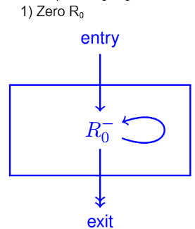
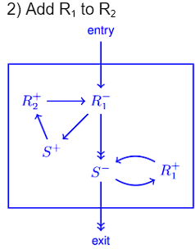
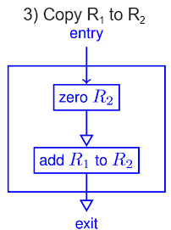
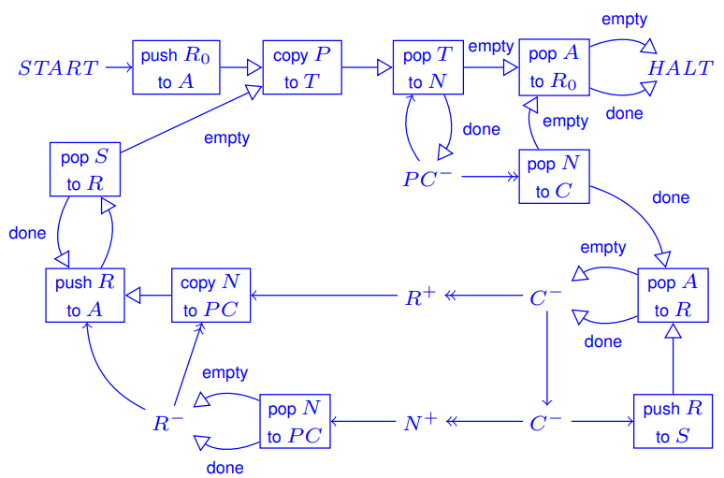
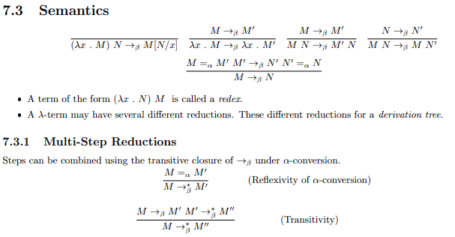
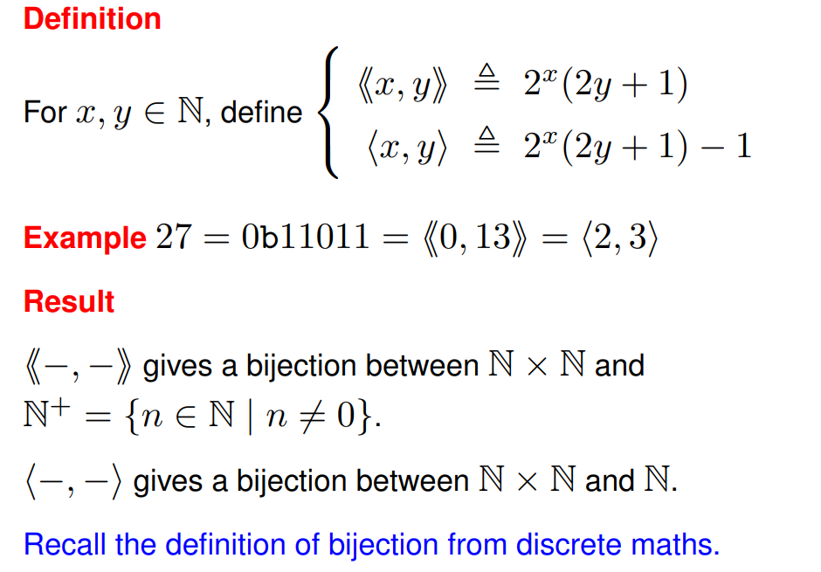
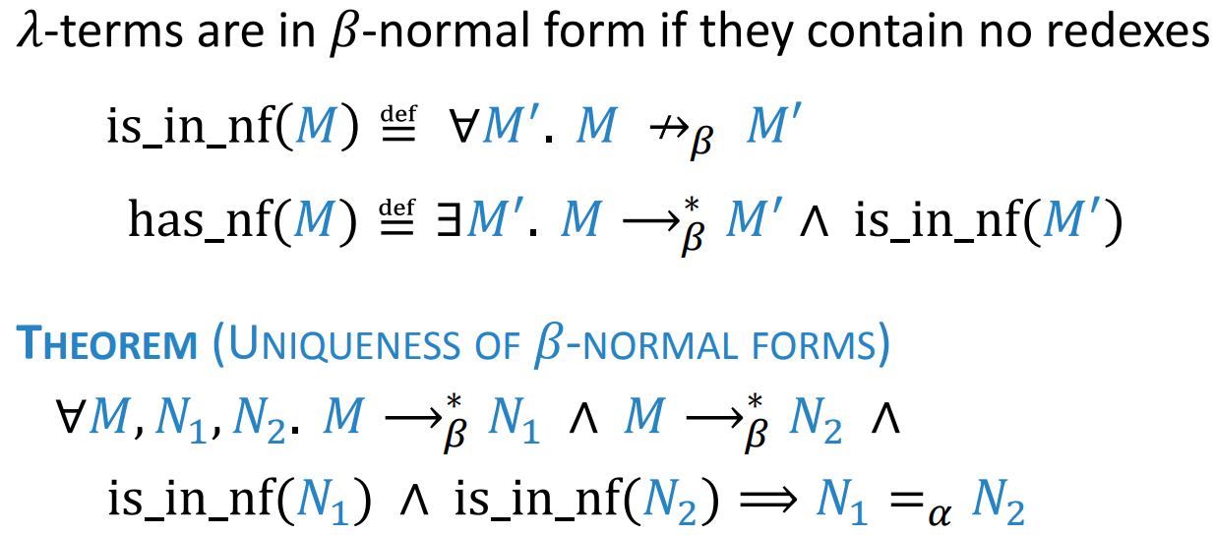
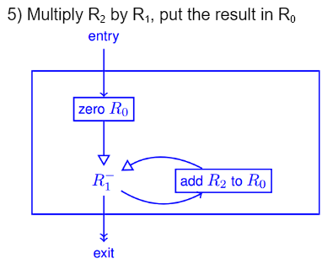
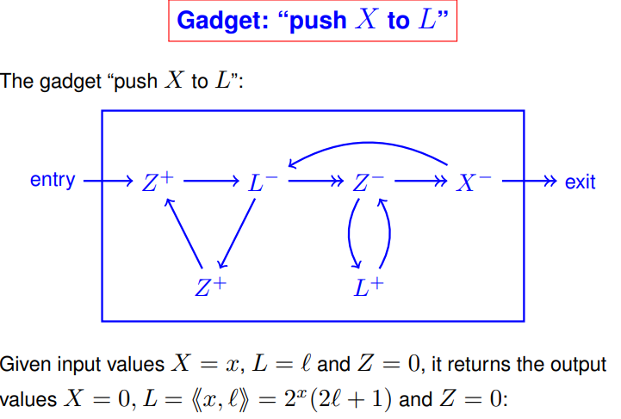
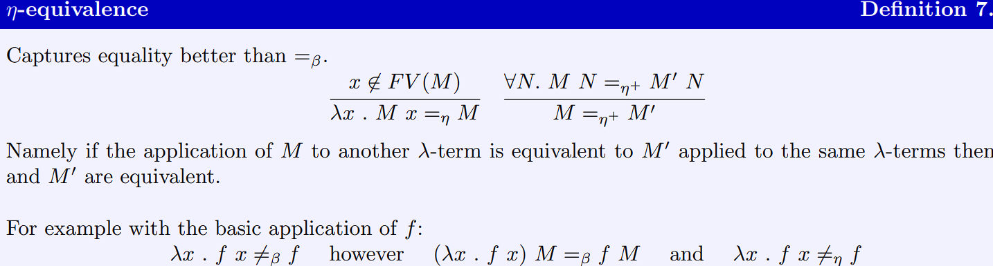
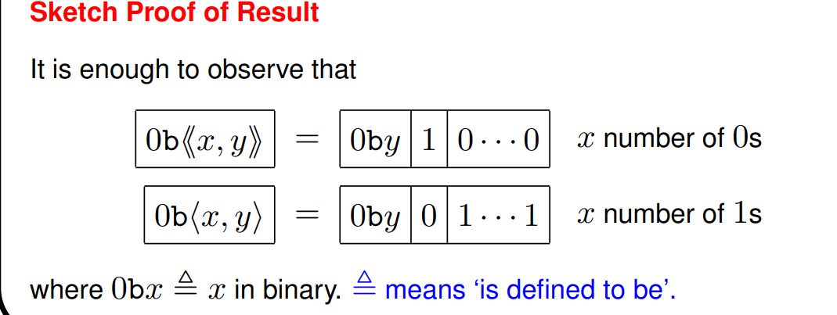
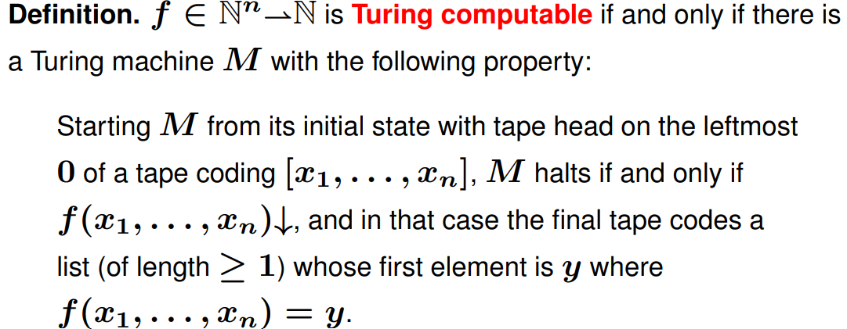
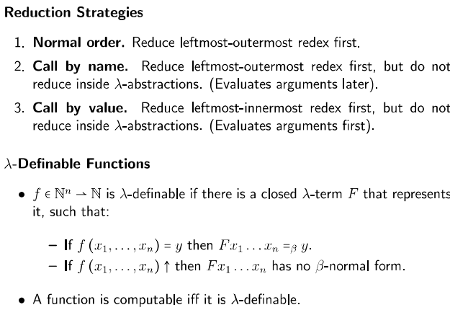
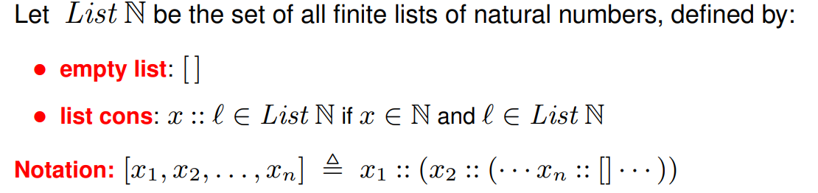
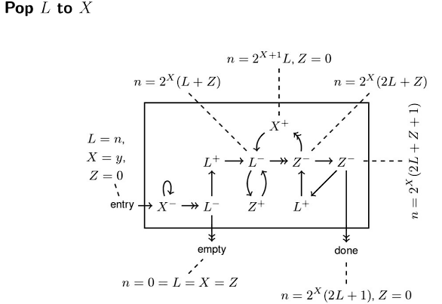
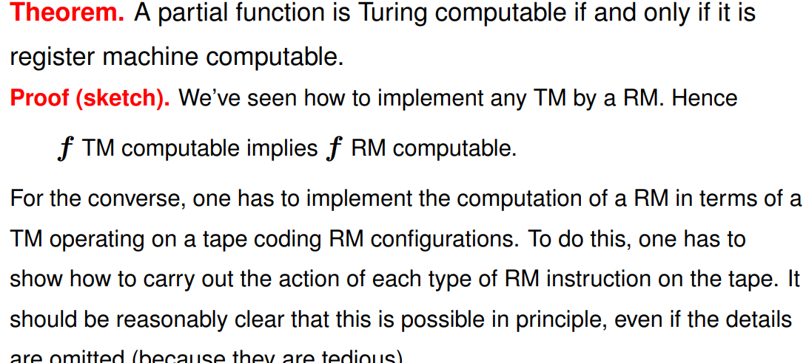
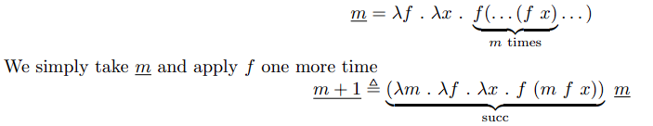
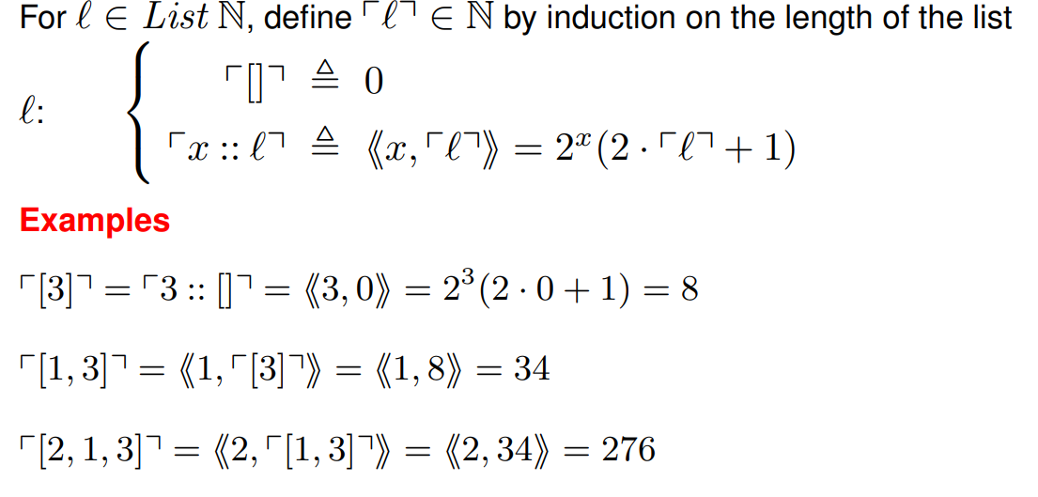
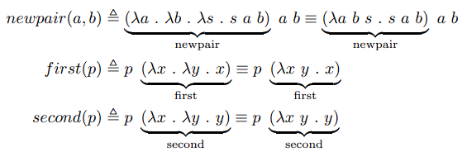
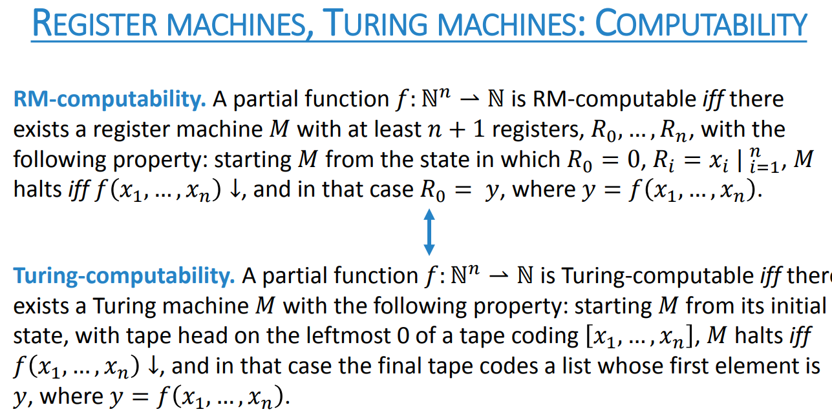
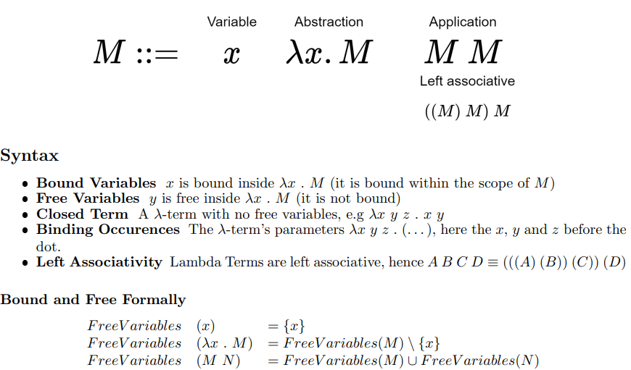
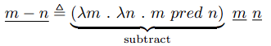
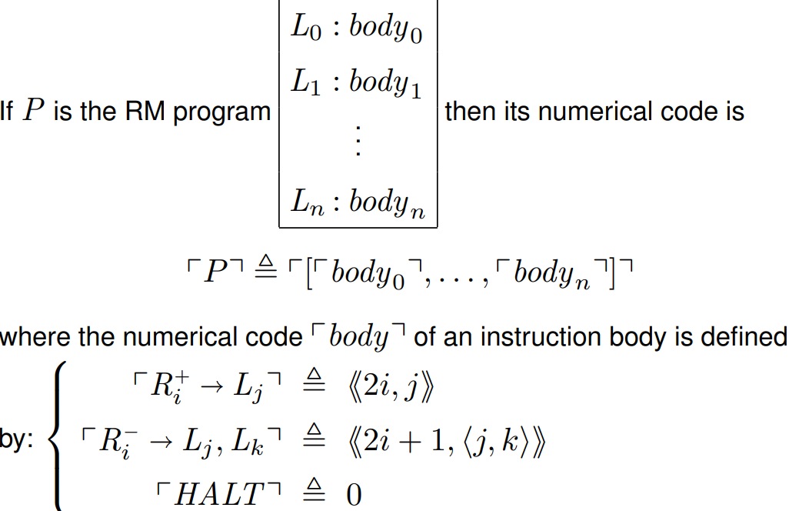
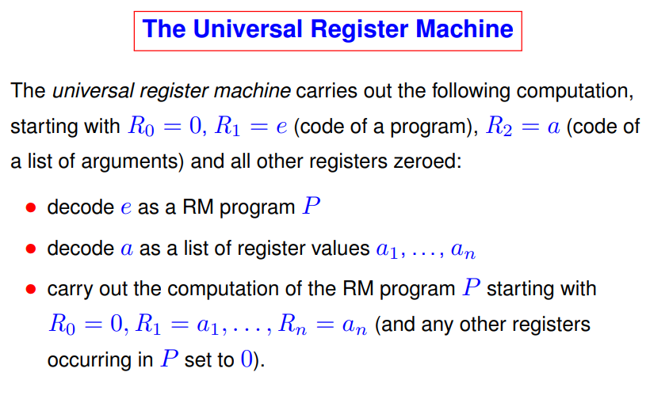
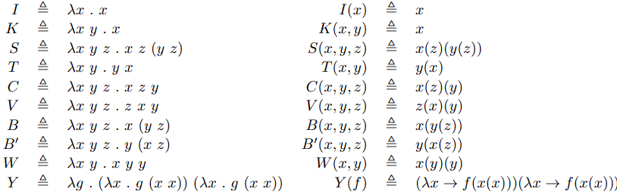
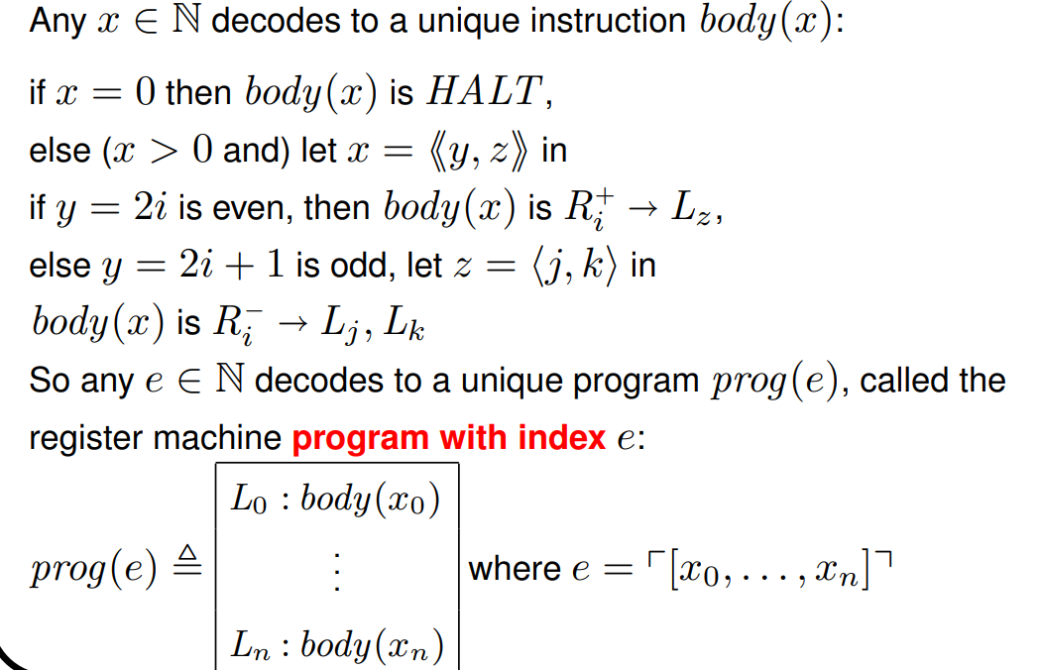
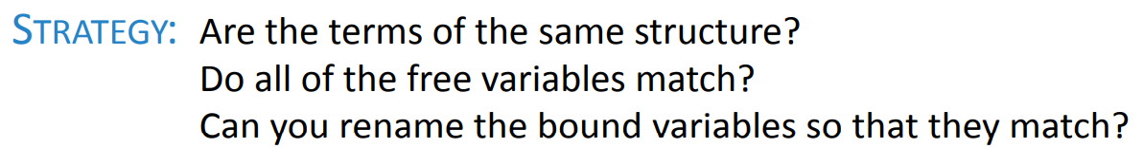
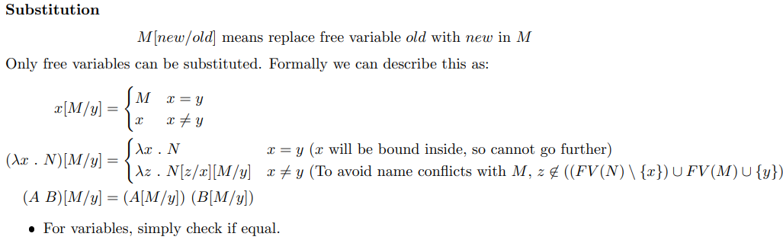
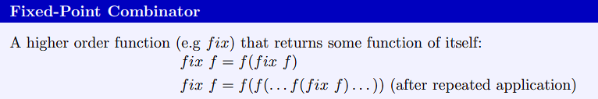
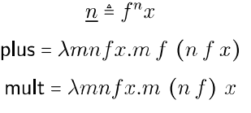









4) Numerical Enc. of Pairs, Lists, Programs
4.1) Pairs
Proof of bijection:
B-Reduction
Lambda calculus is confluent (always arrives at same result), reflexive, transitive.
λ-terms are in normal form if it has no redex. Normal forms are unique:
Not all terms have Normal Forms! They don’t ever reduce to an irreducible – makes sense as lambda calc can implement turing machines which suffer the halting problem. E.g: a lambda calculus term which reduces to itself (λx.x x) (λx.x x)
Innermost Redex A Redex with no redexes inside of Outermost Redex A Redex with no redexes outside
5) Push, Push and Pop work by
removing or adding an item to a list
(numerical encoding of lists).
7) Turing Computability:
4.2) Lists
6) Pop
Note that the first bit, until L+, is basically just doing some checks, and establishing some Preconditions. After that, we basically get to the inverse of the push machine. (Ie, the triangle subtracts 1 from L and then halves). We increase X each time we do this.
6) Successor: We simply take m and apply f one more time
7) Pairs: We can encode pairs as a function, with a selector s function. Hence by supplying first or second as the selector, we can use the pair.
8)
9)
Computability
The minsky and successor machines can build each other. Explain why this supports the Church-Turing thesis. The Church-Turing thesis is that anything that is algorithmically computable is computable by a Turing machine.
Anything that is computable by a Minsky machine is computable by a Turing machine, and hence anything that is computable by a Successor machine is also computable by a Turing machine. The Successor machine can reasonably be seen as a formalisation of an algorithm, which could be implemented. If it could compute anything that is not Turing-computable, it would falsify the Church-Turing thesis. The fact that it cannot therefore supports the thesis.
2) Addition: Since n is the application of f n times
to x, and m is the application of f m times to x, n
+ m is obtained by:
8) Lambda Calculus:
Renaming: When we have a lambda calculus term, we can rename a variable with a different name in all its occurrences, and ensure that it is the same. We might want to do this to prevent name clashes between operations.
α-equivalence
M = _{a}N iff N can be obtained from M by renaming bound variables, or vice versa. The free variable set MUST NOT BE CHANGED (not even renamed).
4.3) Programs
6) The Universal Register Machine:
Combinators
A closed λ-term (no free variables), usually denoted by capital letters
Only SKI are required to define any computable function (can remove even λ-abstraction, this is called SKICombinator Calculus). The Y -Combinator is used for recursion. In one step of β-reduction: Y f →β f (Y f) We cannot define λ-terms in terms of themselves, as the λ-term is not yet defined, and infinitely large λ-terms are not allowed.
Mnemonics for the registers of U and the role they play:
R₀ = result of simulated RM computation (if any)
R₁ = Program code of RM to be simulated,
R₂ = list of RM arguments R₃ = PC
R₆ = label number of next instr – also holds c
ode of curr instr.
R₅ = code of curr instruction body.
R₆ = value of register to be used by current instruction. R₇ and R₈ are auxiliary registers,
R₉ onwards are scratch registers.
Substitution
You cannot swap a bound variable out, and you can’t swap in a variable that was bound.
Church Numerals
1) We represent natural numbers as Church Numerals – n repeated applications of our function f:
3) Multiplication:
4) Exponential
5) Gadgets
Partial Reg Machine graph, with one entry wire and one or more exit. Operates on input and output regs specified in gadget name, but may also use other scratch registers (YOU MUST ZERO THEM). Scratch regs assumed to be set to 0 initially.
Church Turing Thesis
5) Conditional:
If m = 0 = λf . λx . x then x is returned, which will be x1. If not zero, then
the f applied returns x2, so any number of applications of f, results in x2.

